Slide 1
My CAR-T Journey
A new approach to Secondary Progressive MS
Participant, CAR-T Cell Trial for RRMS & SPMS — University College London Hospitals (UCLH)
[Your name] · [Date]
Notes:
Welcome the group and thank them for having you. Introduce yourself briefly, and say you're going to talk about your experience taking part in a CAR-T cell trial for MS at UCLH, what CAR-T is, and why it mattered so much given how few options exist for SPMS. Fill in your name and the date on this slide.

Slide 2
MY STORY
Living with Secondary Progressive MS
2013
A single episode following the birth of my son
1
2017
Started to deteriorate
2023
Diagnosed with MS — with SPMS
licensed SPMS drug available
For SPMS, licensed treatment options are almost non-existent compared with relapsing MS.
Siponimod — and it wasn't one I could tolerate
The one drug that is licensed for SPMS — siponimod — I could not tolerate.
2
Notes:
Walk through your timeline: a single episode in 2013 following the birth of your son, a gradual deterioration from 2017, and diagnosis in 2023 with SPMS. The licensed SPMS drug is siponimod — briefly explain why it wasn't tolerable for you; this sets up why the trial mattered.

Slide 3
THE BIGGER PICTURE
Why SPMS Needed a New Option
RRMS
SPMS
Relapsing-Remitting MS
Secondary Progressive MS
Multiple licensed disease-modifying therapies
Almost no licensed treatment options
New options added regularly
The one available option isn't tolerated by everyone
Choice if one drug isn't tolerated
Few alternatives once that door is closed
3
Notes:
Make the point that while people with RRMS have several licensed drugs to choose from, SPMS patients have very few — which is the context for why a new approach like CAR-T is so significant.

Slide 4
THE SCIENCE, SIMPLY
What Is CAR-T Therapy?
A type of immunotherapy — originally developed to treat blood cancers — now being trialled in MS.
The goal: reset the immune system by depleting the B cells believed to drive the immune attack in MS.
re-engineered to target
Available for both RRMS and SPMS
T cell
B cell
This trial tests CAR-T across both relapsing and secondary progressive MS.
believed to drive the immune attack in MS
4
Notes:
Explain CAR-T in plain terms: it's an immunotherapy that started in cancer treatment, and it's now being trialled for MS. The core idea is resetting the immune system by removing the B cells thought to drive MS. Mention that the trial covers both RRMS and SPMS.

Slide 5
THE MECHANISM
How CAR-T Works
01
02
03
04
Collect
Re-engineer
Infuse
Eliminate
T cells are collected from the blood
In the lab, T cells are redesigned to recognise B cells
The engineered T cells are returned to the body
They target and eliminate B cells — aiming for remission and slower progression
5
Notes:
Walk through the four steps: collecting T cells from the blood, re-engineering them in the lab to recognise B cells, infusing them back into the body, and then the engineered cells targeting and eliminating B cells — with the hope of remission and slower disease progression.

Slide 6
MY DECISION
Why I Said Yes
“With treatment options for SPMS almost non-existent, and the one licensed drug something I couldn’t tolerate — joining this trial felt like a no-brainer.”
1
Open to both RRMS and SPMS
2
Aims for remission, not just slowing symptoms
3
A chance to influence future SPMS treatment
6
Notes:
This is a good moment to speak personally and from the heart about your decision to join — why the lack of alternatives, and the potential for remission rather than just symptom management, made it feel like the right choice for you.

Slide 7
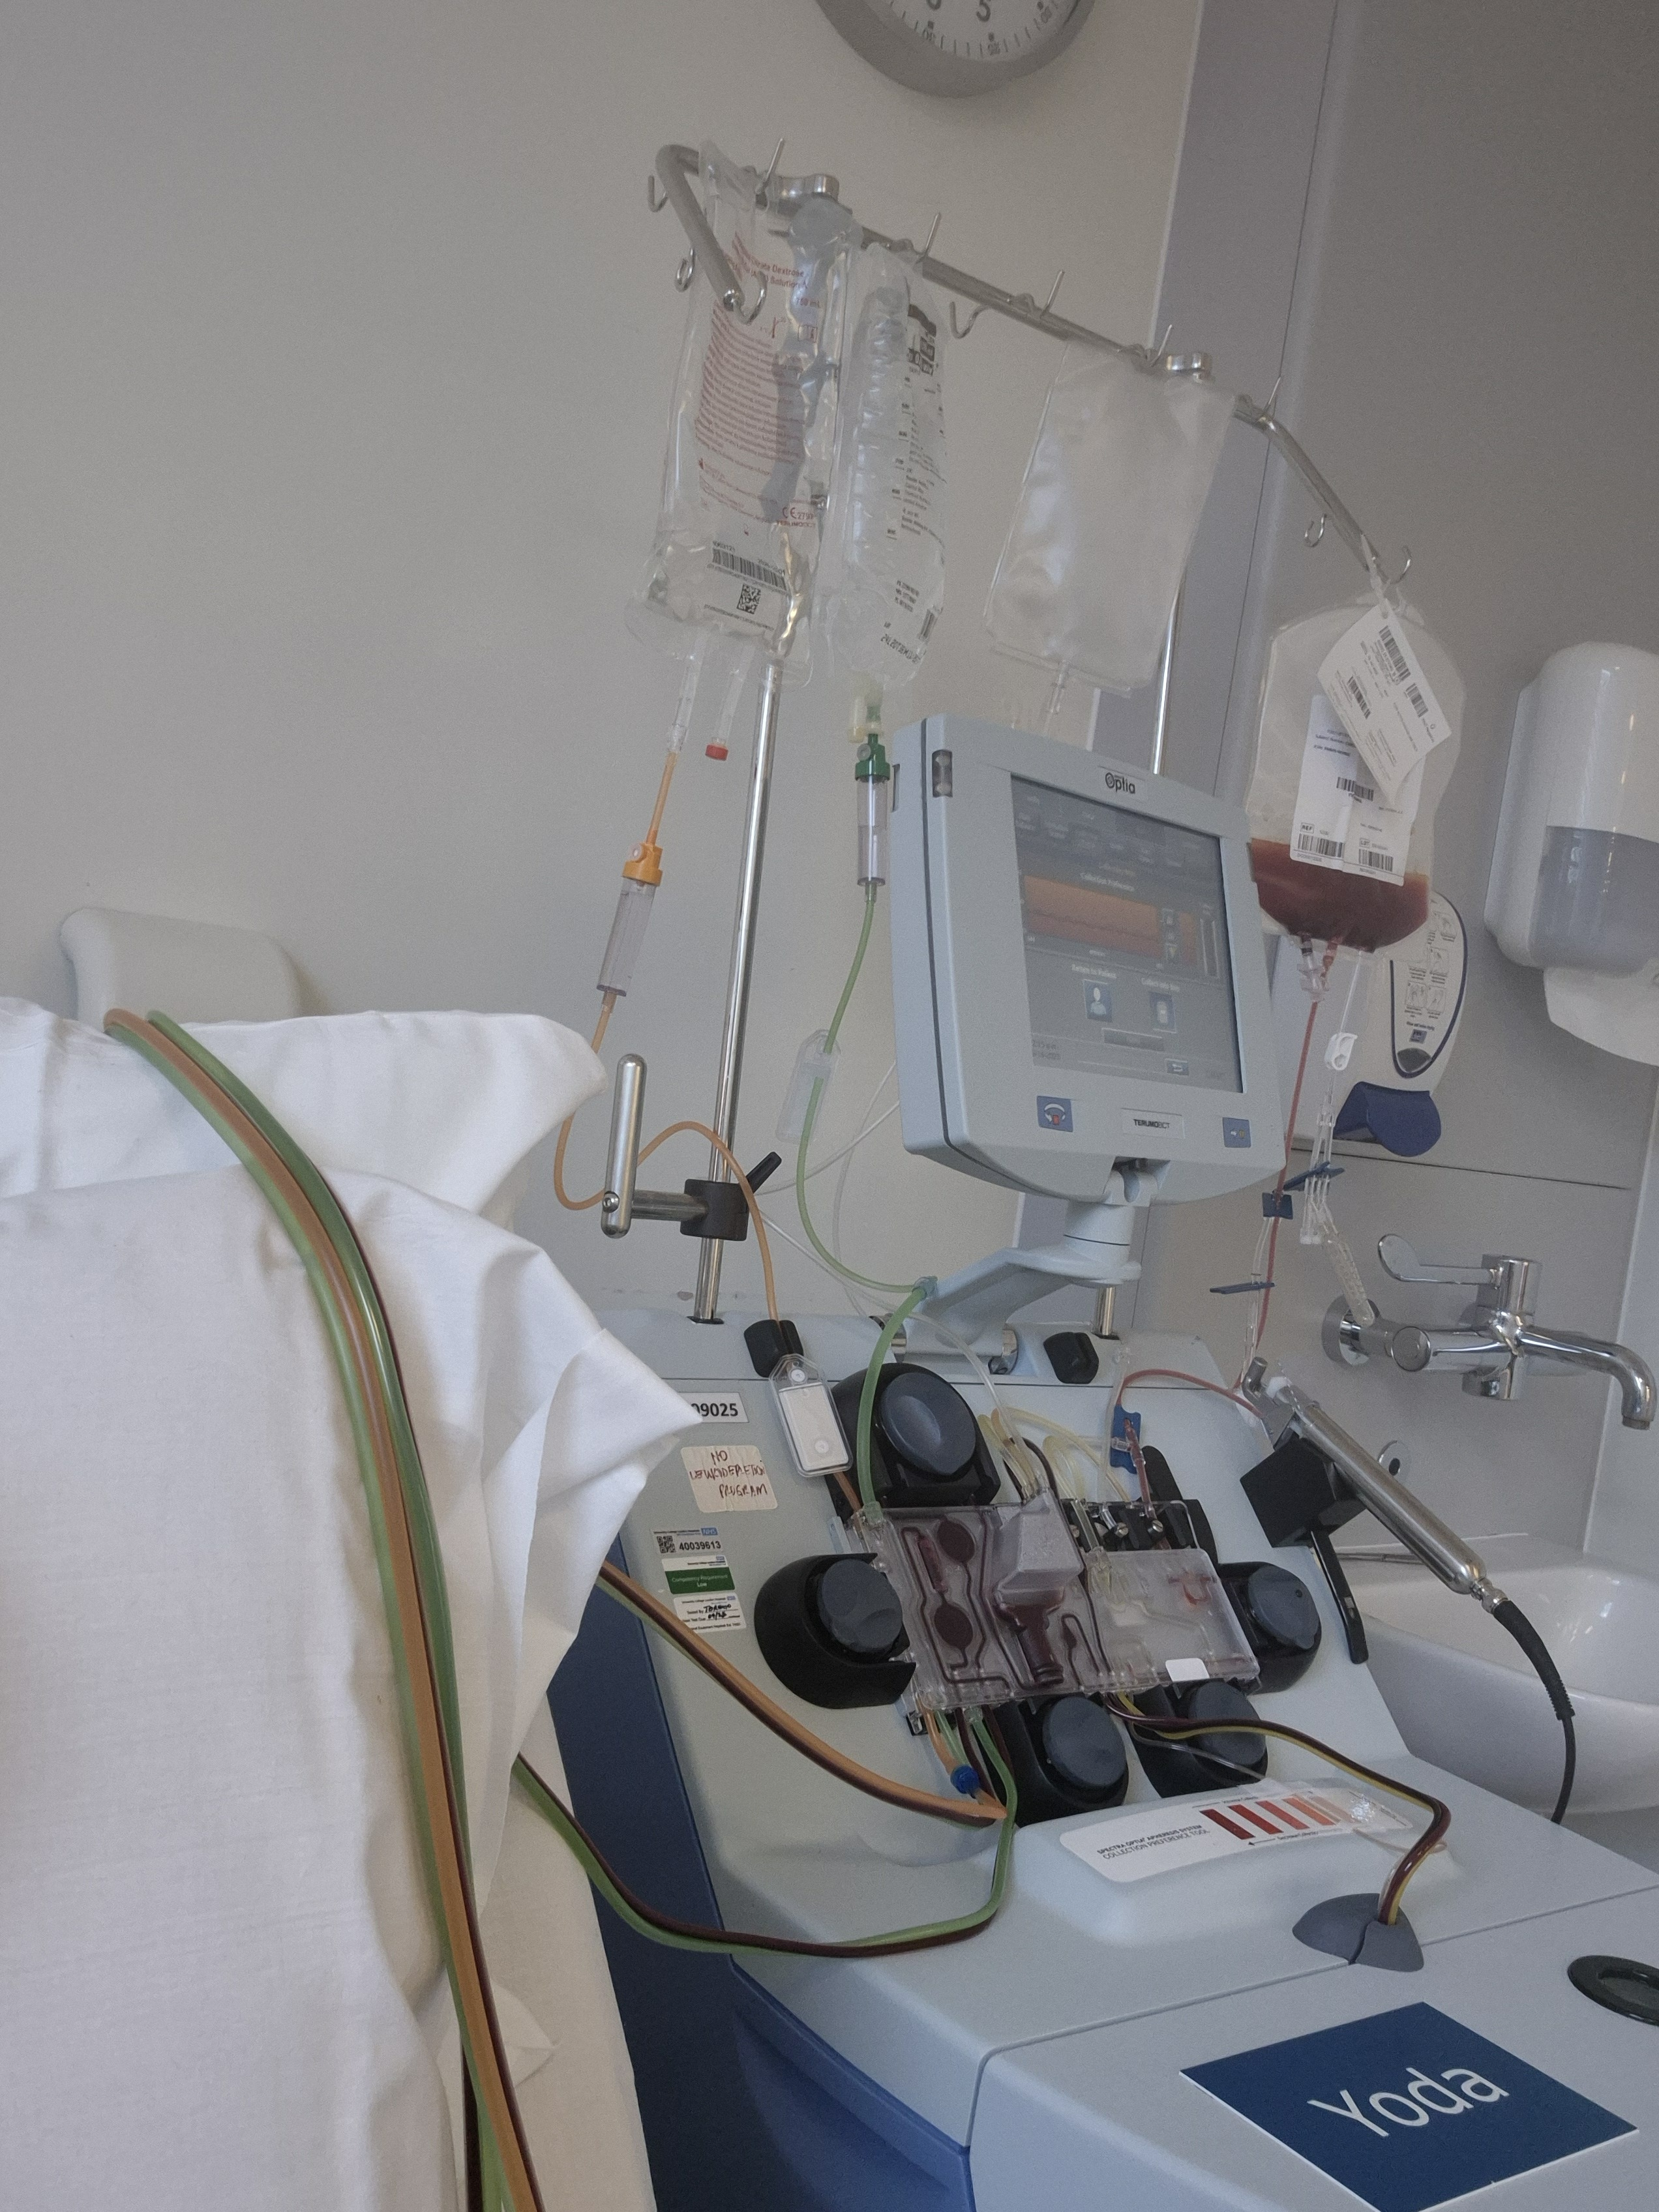
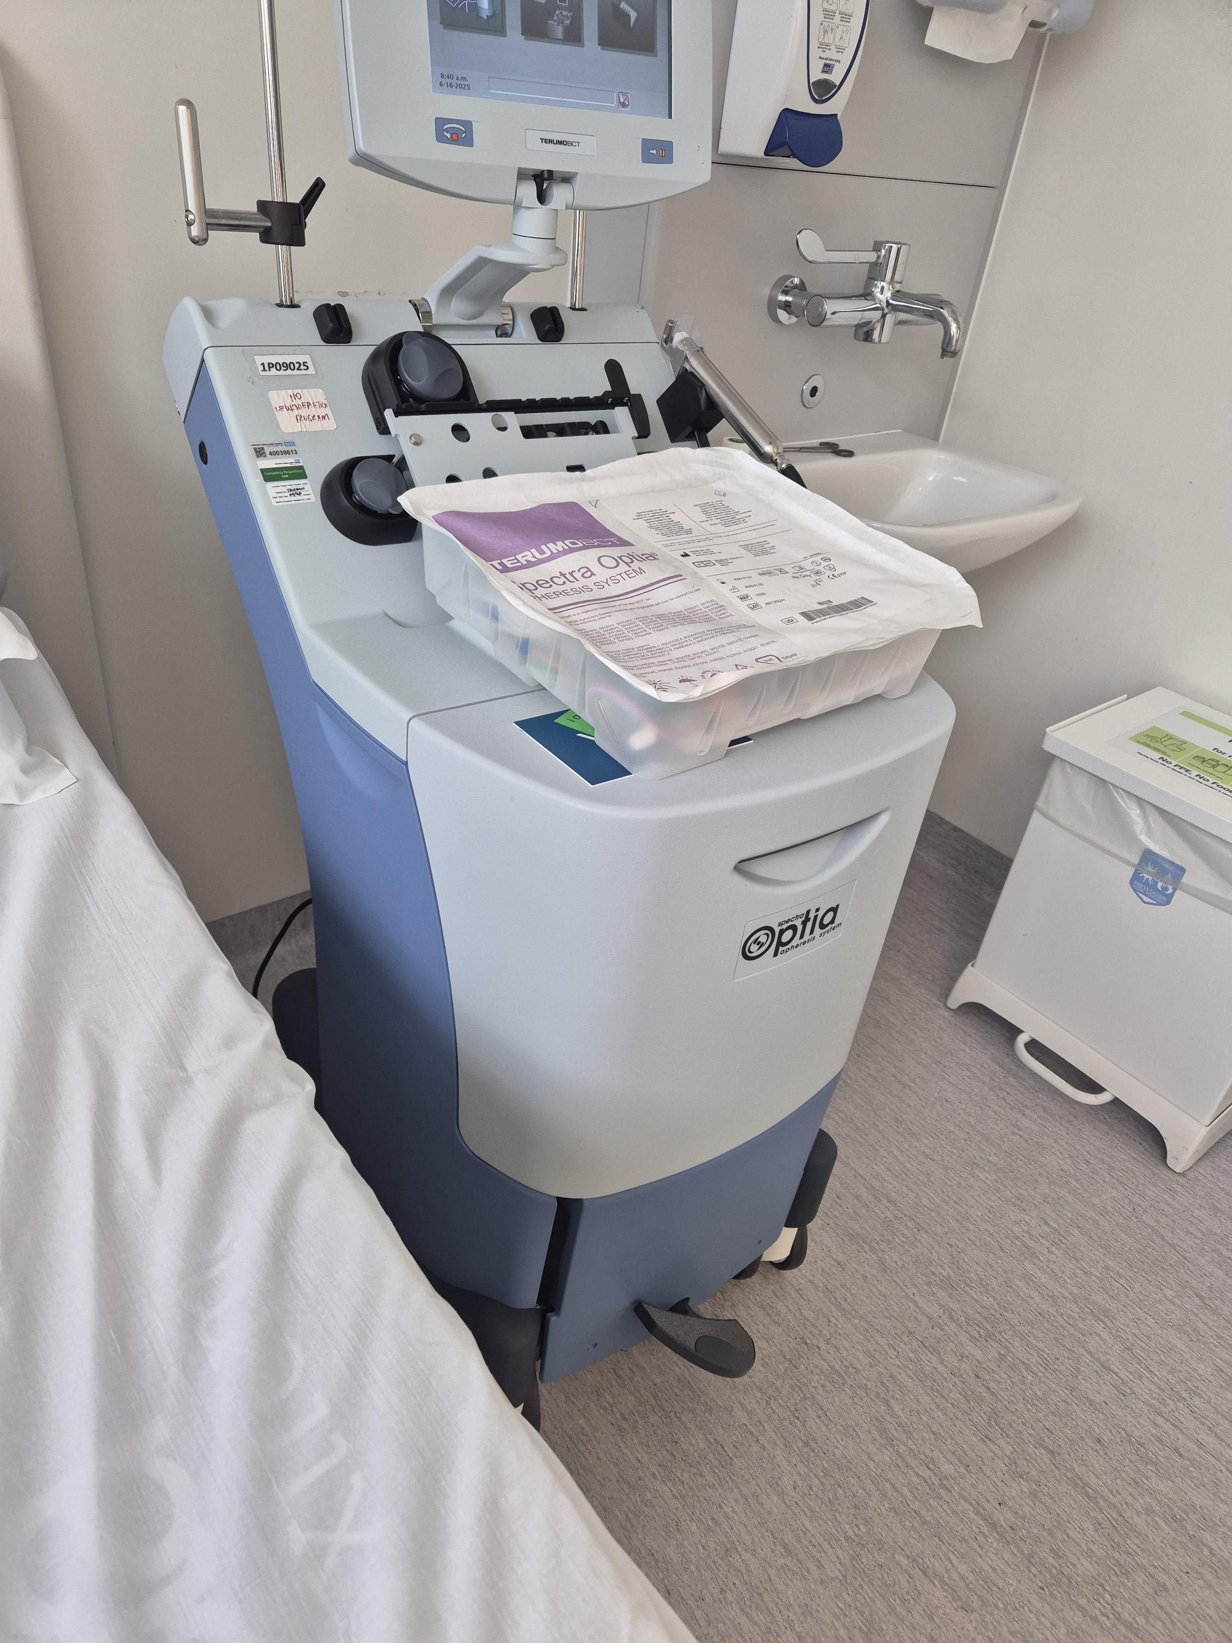
THE TRIAL
Getting Ready
Consultation
Meetings with the trial team to talk through the trial, its risks and potential benefits
Baseline tests
Bloods, ECG, height, weight and other checks to confirm eligibility
T-cell collection
(Leukapheresis)
A central line was inserted into my groin and attached to a machine that filtered my blood and collected the cells needed — about 6 hours, and I was wiped out afterwards
The machine that collected my cells
7
Notes:
Walk through the run-up to the trial: the consultations where the team explained the risks and benefits, the baseline health checks, and then the T-cell collection itself — a central line in the groin connected to a machine that filtered your blood over about 6 hours, leaving you wiped out afterwards.

Slide 8
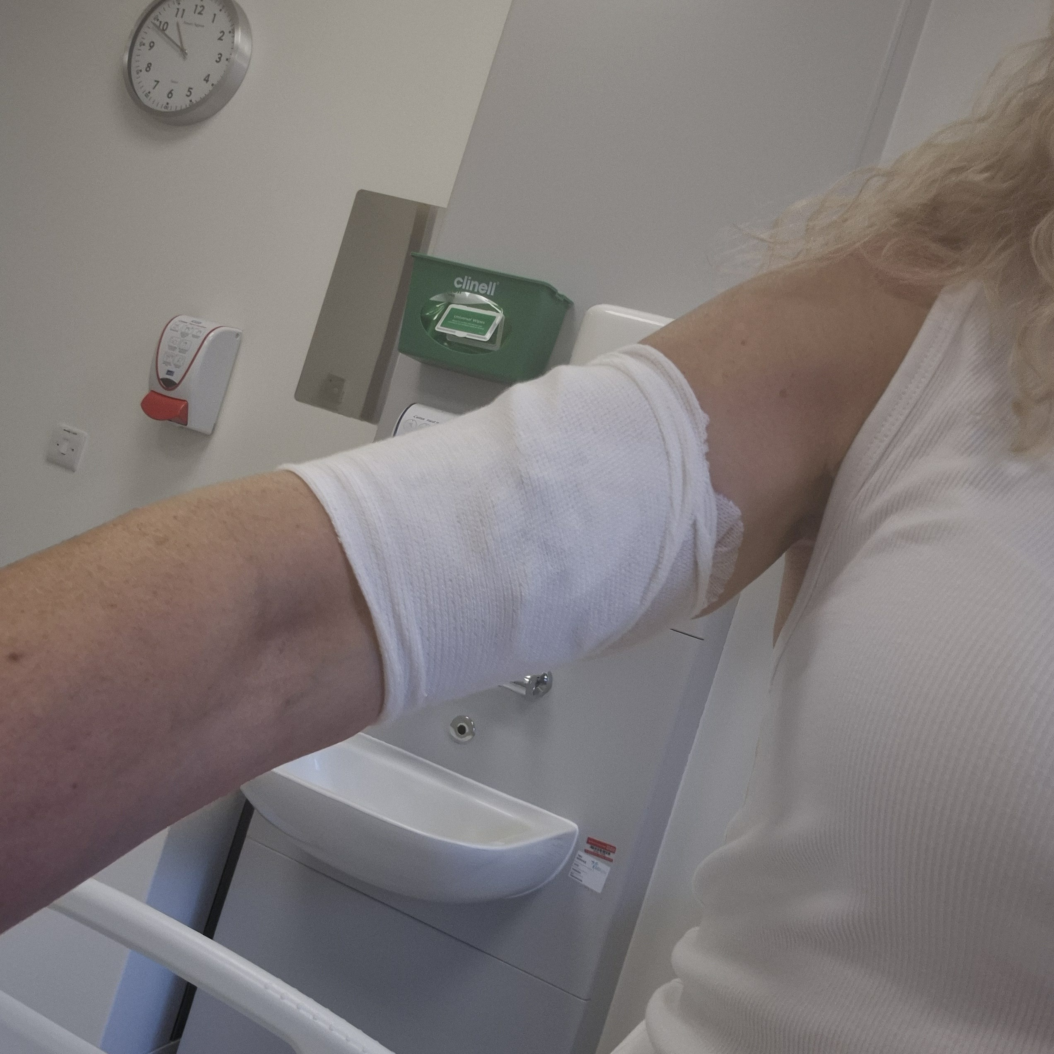
THE TRIAL
Admission — and a Setback
The wait
A couple of months later, the call came — my cells had been engineered abroad (sent to Germany and the US) and were ready
Admission
18 September: admitted to hospital with a suitcase, expecting to be away for at least a month
PICC line
Inserted into my arm in theatre under local anaesthetic — around an hour
COVID setback
Back on the ward, the team came in wearing masks — I had COVID. Sent home to recover and wait for a new date
PICC line ready
8
Notes:
Cover the wait for the manufactured cells, admission day with the suitcase, the PICC line procedure — then the setback: testing positive for COVID on the ward and being sent home to recover before a new admission date could be set. This is a good moment to be honest about how that setback felt.

Slide 9
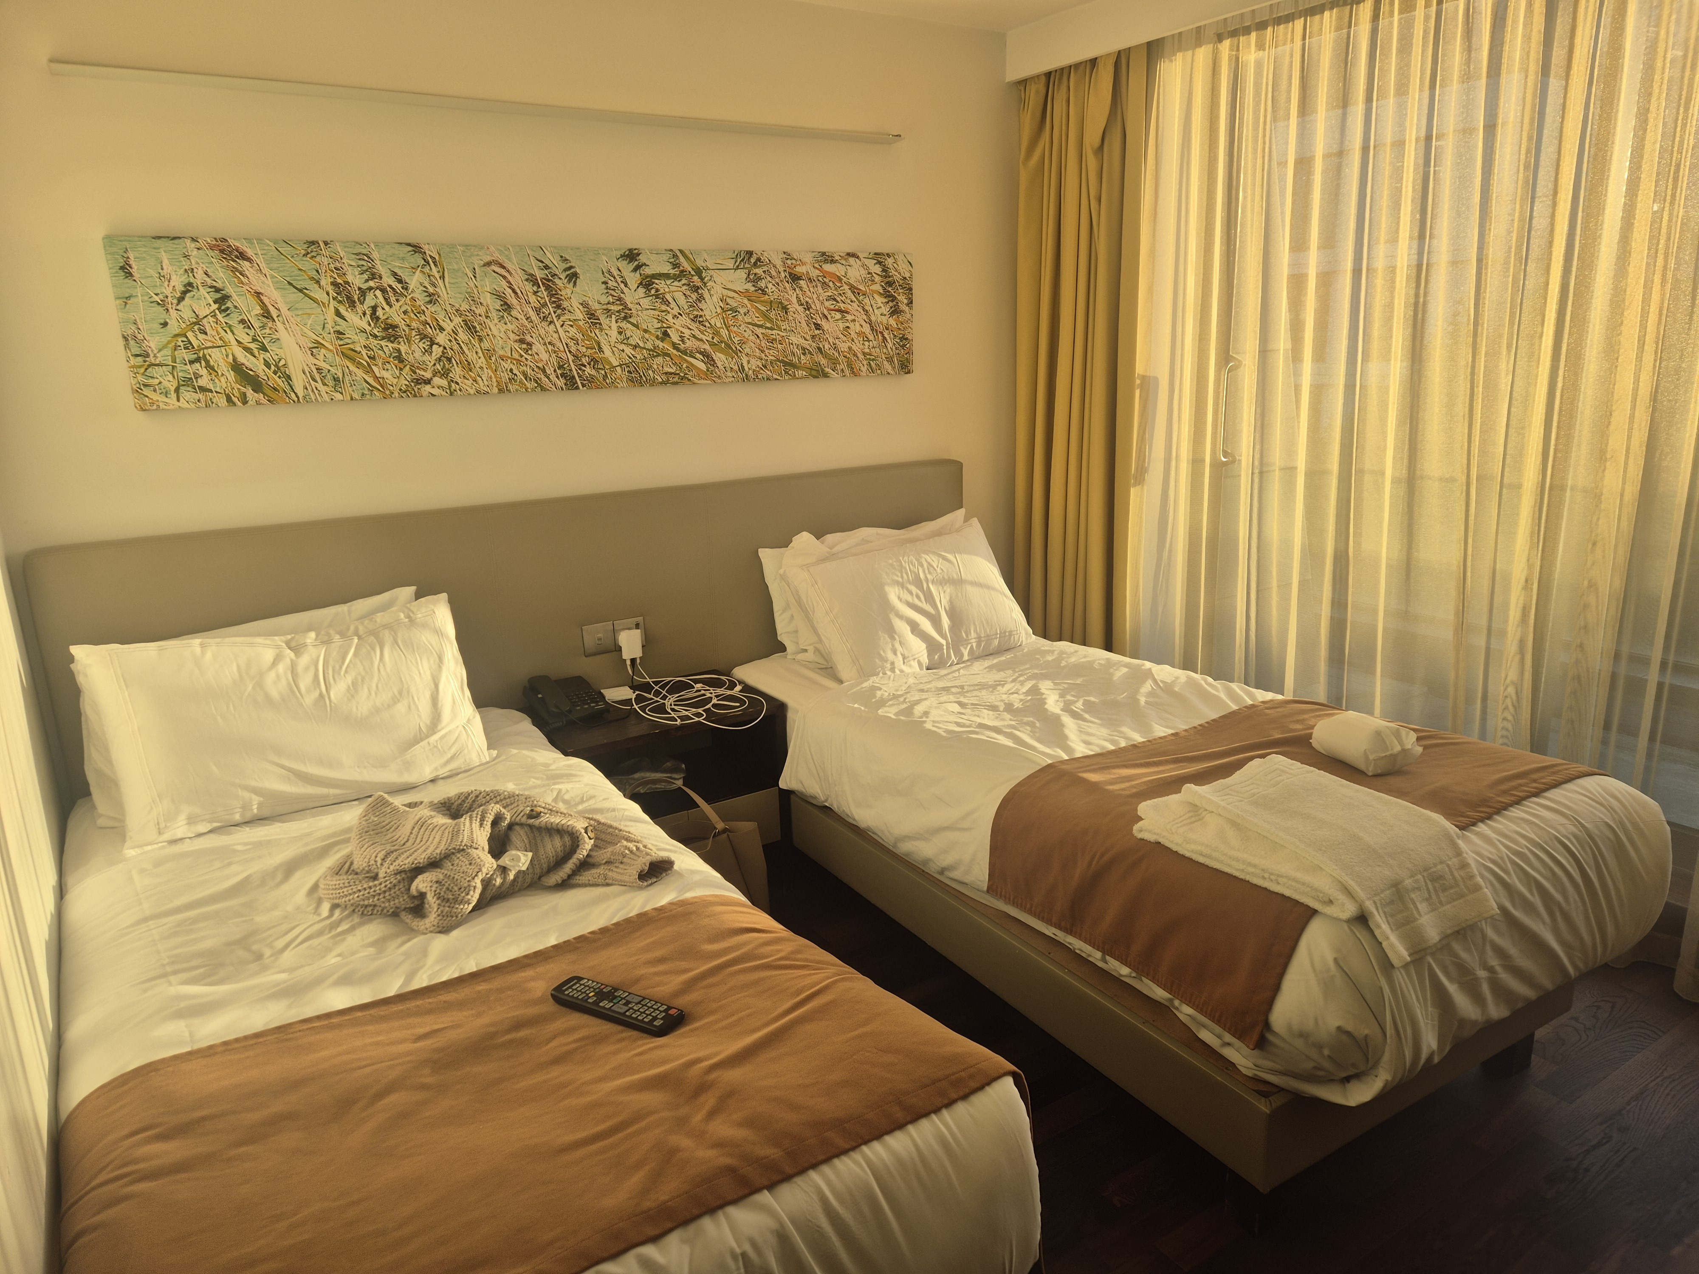
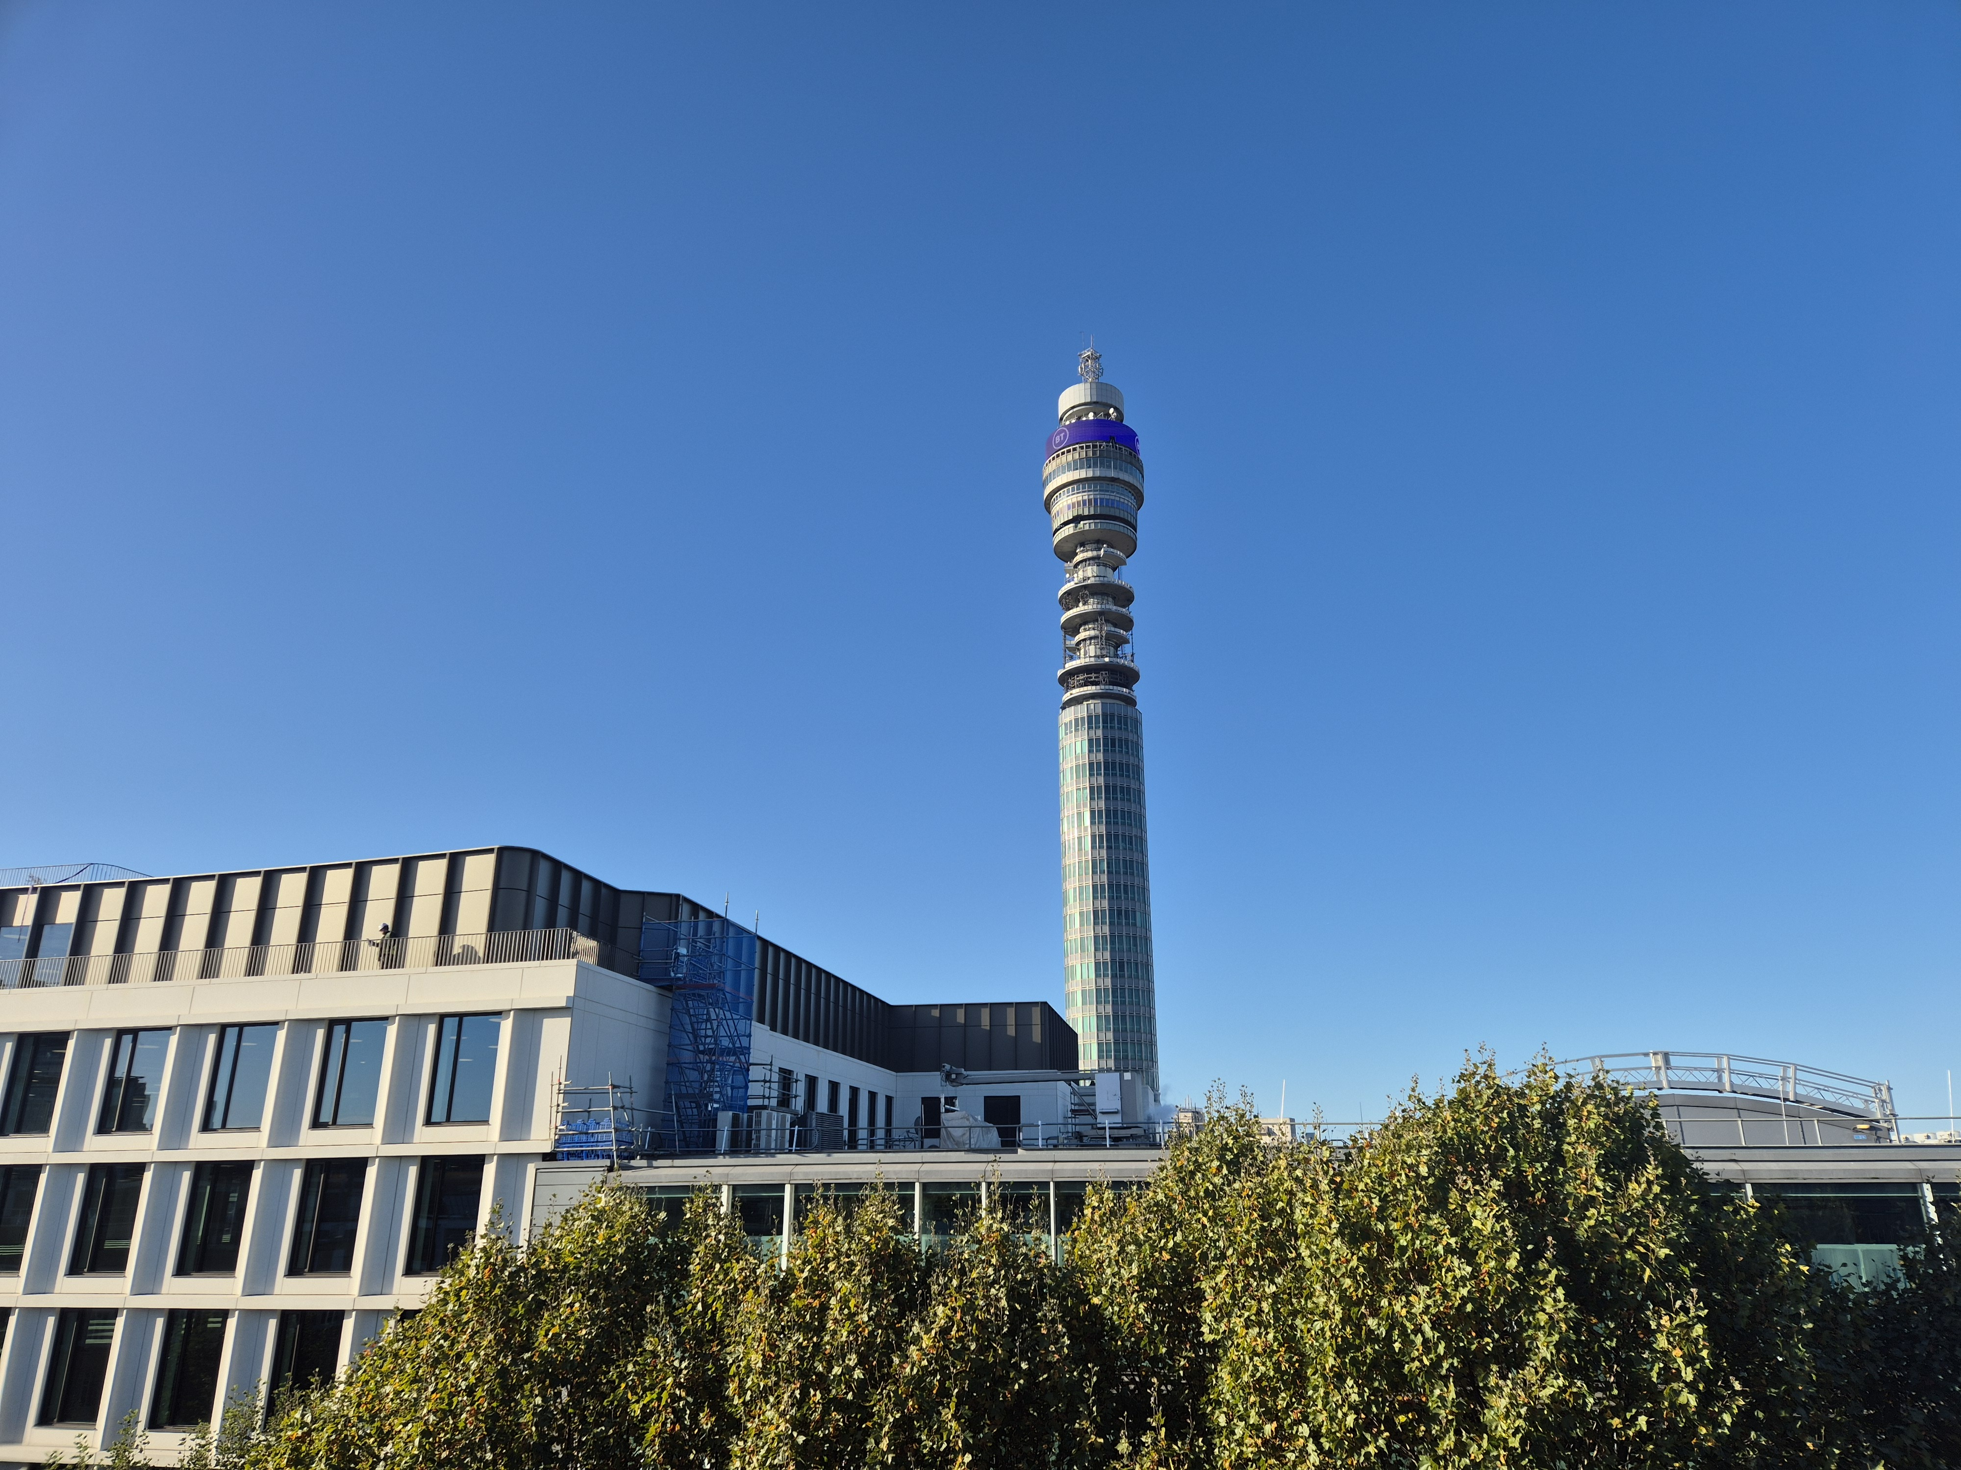
THE TRIAL
Back for Treatment
Readmission
Readmitted in October — about a month later than planned. My PICC line was still in, so I went straight into chemo
Conditioning
Sent to the hospital's hotel, then back for round 1 of chemo (about 2 hours) before resting at the hotel — back again the next day for more. Afterwards: no shops or busy places, mask at all times
Final checks
More bloods were taken to make sure I was fit to go ahead
The hospital's hotel
9
Notes:
You were readmitted in October, about a month later than planned because of the COVID delay. Since the PICC line was already in place, you went straight into chemo (conditioning) without needing it re-inserted. Cover the conditioning chemotherapy rounds and the final blood checks before infusion — the infusion itself gets its own slide next.

Slide 10
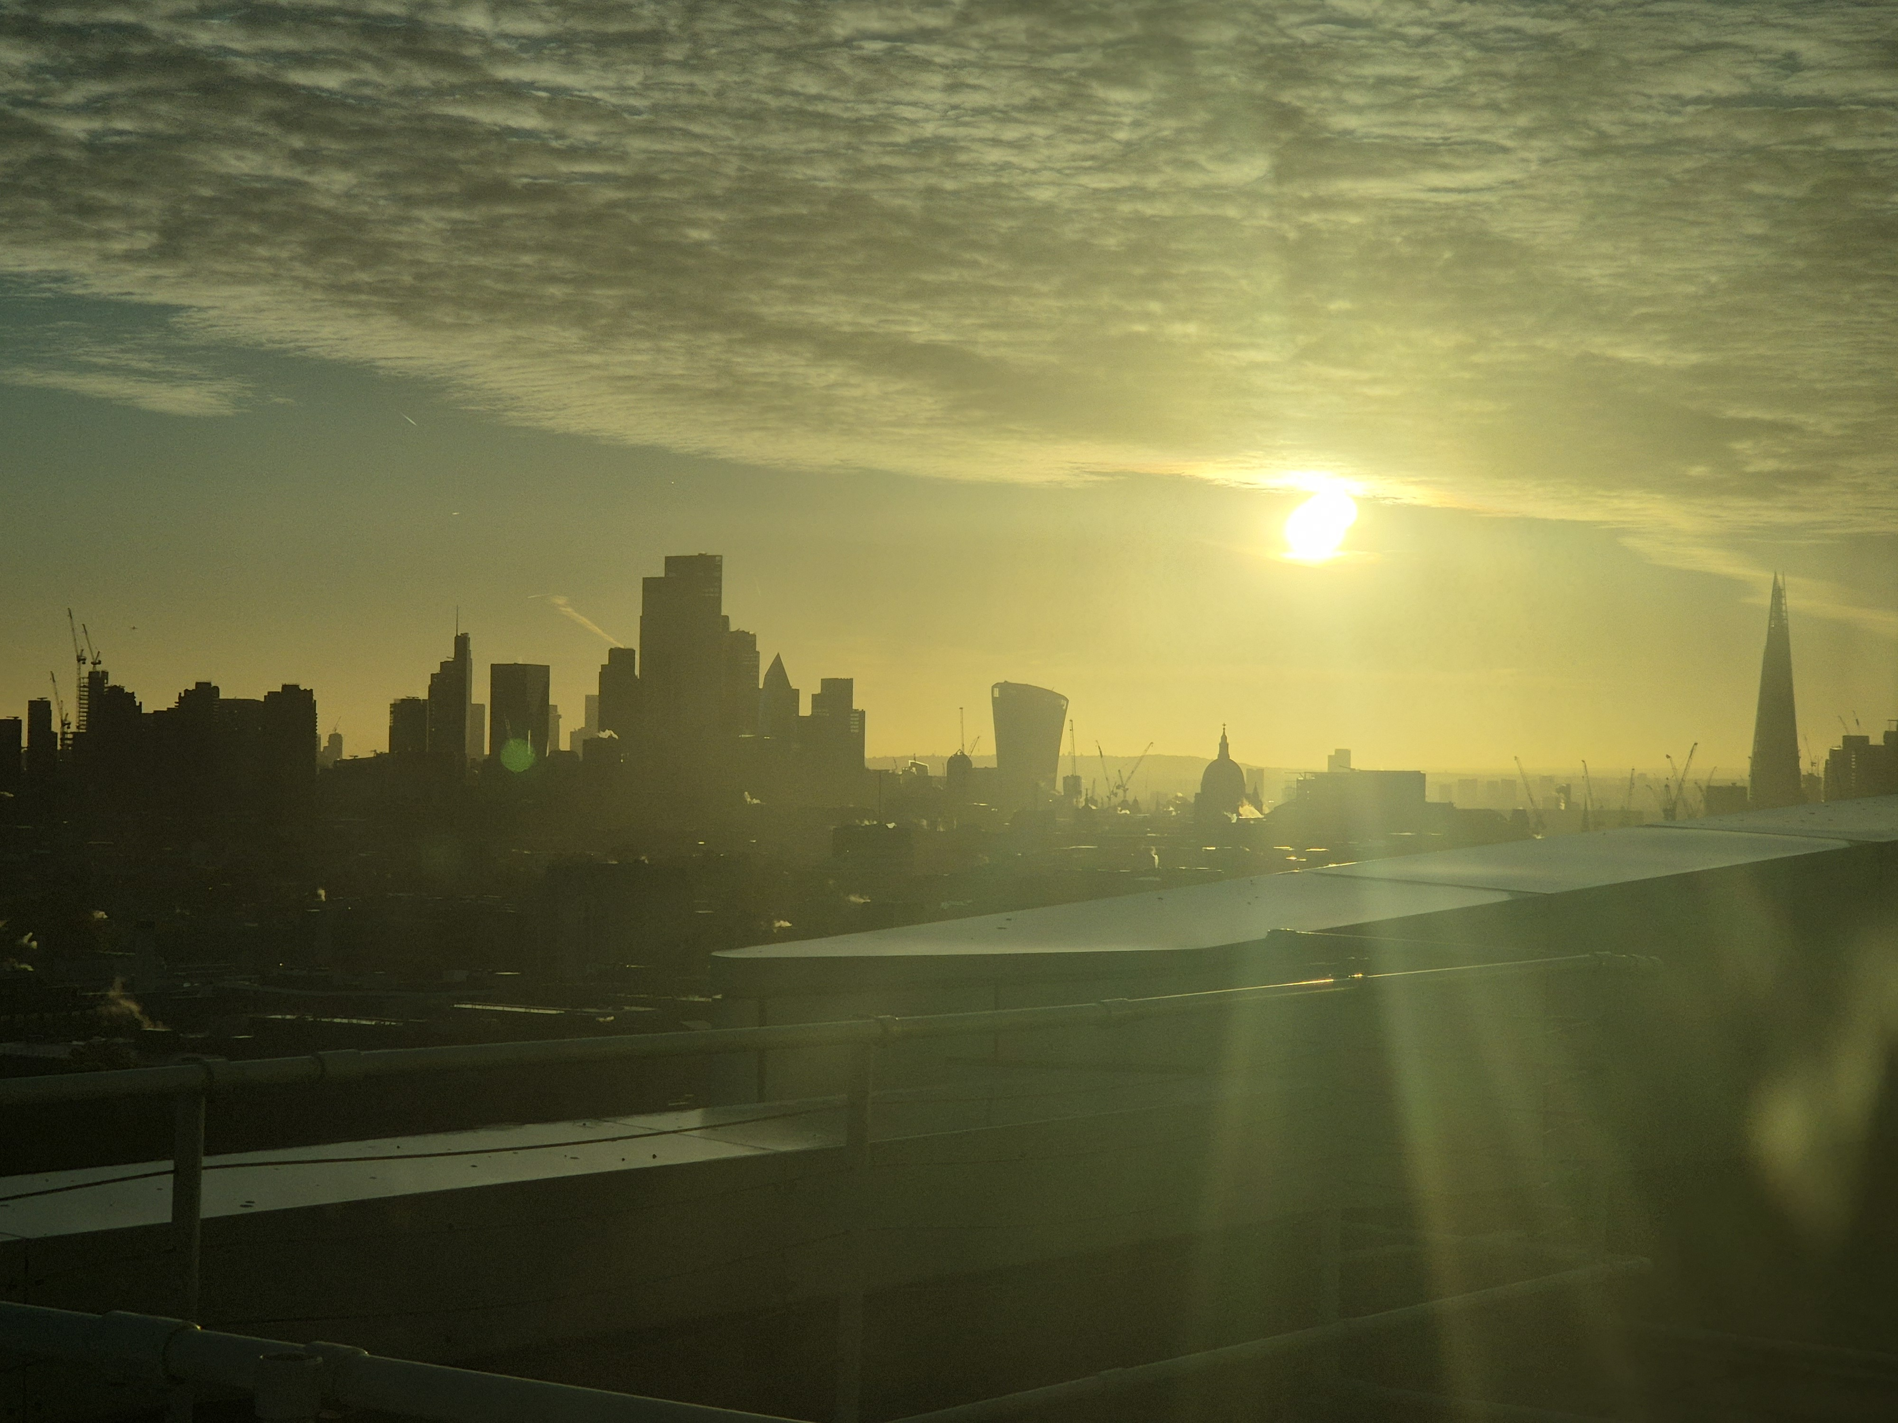
THE TRIAL
An Unexpected Turn
Day 1
Day 2
Day 3
No effect at all
Exhausted, and mildly nauseous
Felt very unwell — had to lie down after chemo, then started being sick two hours later
It got worse through the night. Alone in my room, faint and barely able to walk, I somehow made it back to the hospital while still being sick. They put me on a drip and admitted me immediately — not to the planned CAR-T unit, but to a ward in the main hospital tower.
One silver lining — the new ward had a view right across London.
The view from the tower
10
Notes:
This is a pivotal, honest moment in the talk. Day 1 of chemo had no effect, day 2 brought exhaustion and mild nausea, and day 3 hit hard — lying down after chemo, then vomiting that worsened through the night while alone. Getting back to the hospital faint and unwell led to an emergency admission — on a general ward rather than the planned CAR-T unit — with a drip put up straight away. It's worth pausing here; audiences respond to the honesty of this part. The view across London is a small, human note to end on before moving forward.

Slide 11
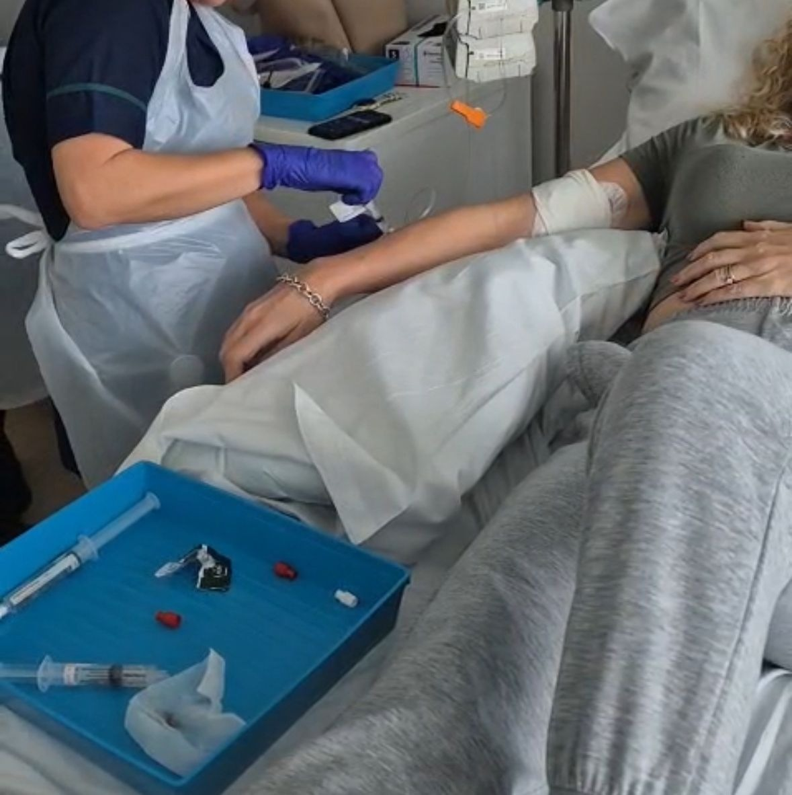
THE TRIAL
Infusion Day
After a few rest days, it was time — the CAR-T cells were infused through a catheter (not the PICC line). The biggest day of the trial, over in moments.
01
02
Frozen arrival
Careful handling
The cells arrived in a huge container, kept frozen
The nurse put on special gloves to remove the vial of cells
03
04
The infusion
Day 1
A very small amount of clear liquid was injected into the cannula
That was it — the clock started on 14 days in hospital for monitoring
The CAR-T cells going in
11
Notes:
After the setback, there were rest days before the actual infusion — through a catheter, not the PICC line. Walk through how the cells arrived frozen in a large container, the nurse's careful handling with special gloves, and how such a small amount of liquid — over in moments — was the culmination of months of preparation. Make sure to land the anticlimax: such a big moment, physically so quick. Then note that day 1 started a mandatory 14-day hospital stay for monitoring.

Slide 12
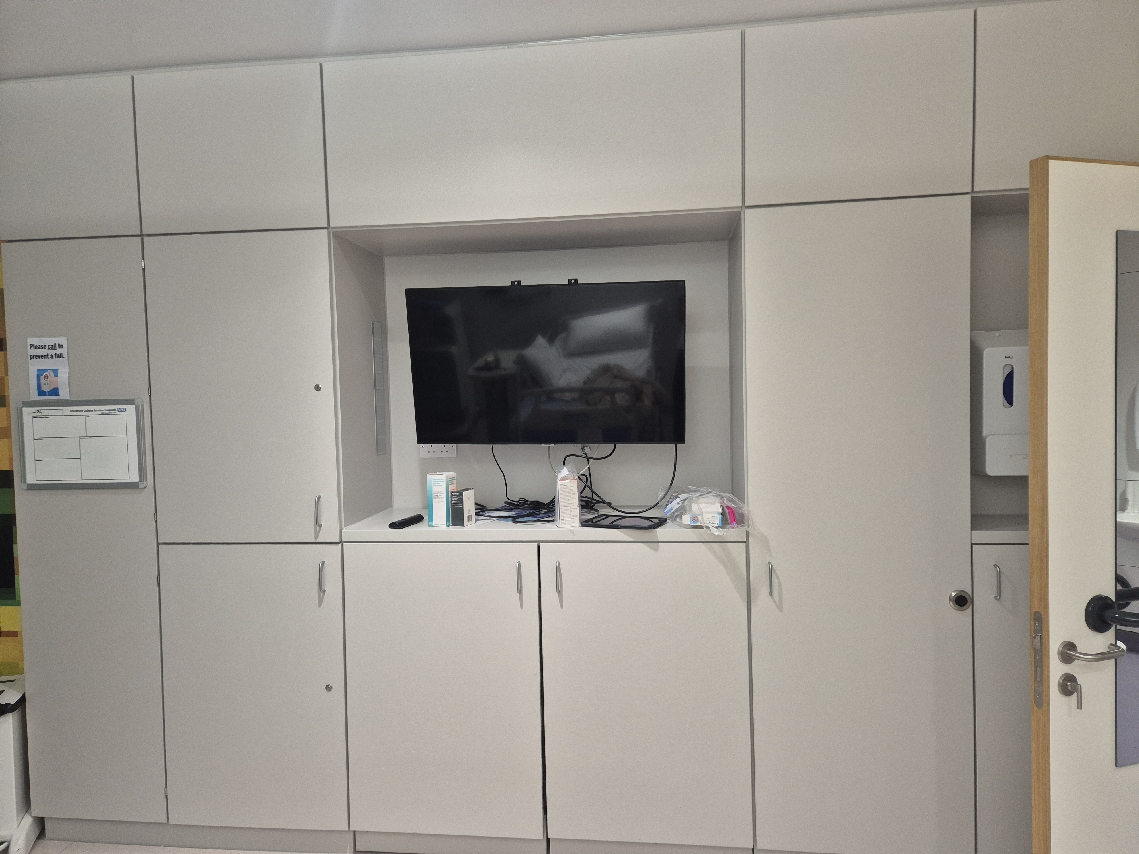
THE TRIAL
The 14 Days
Day 2
The exhaustion started to set in
Day 4
Moved to my own room in the specialist building
Days 5–6
Total exhaustion
Day 7
A next-level headache hit, lasting for days — IV paracetamol helped a bit
Days 11–12
Started to get better
My new room
Day 15
Sent home
Every day in hospital: bloods were taken to measure how well my recovery was going, and to highlight any risks and infections.
12
Notes:
Walk through the 14-day hospital stay: exhaustion setting in on day 2, moving to your own room in the specialist building on day 4, total exhaustion on days 5 and 6, then a severe headache from day 7 that lasted for days — IV paracetamol took the edge off. Things started to improve around days 11–12, and you were sent home on day 15. Mention that bloods were taken every single day to measure how well recovery was going and to highlight any risks and infections.

Slide 13
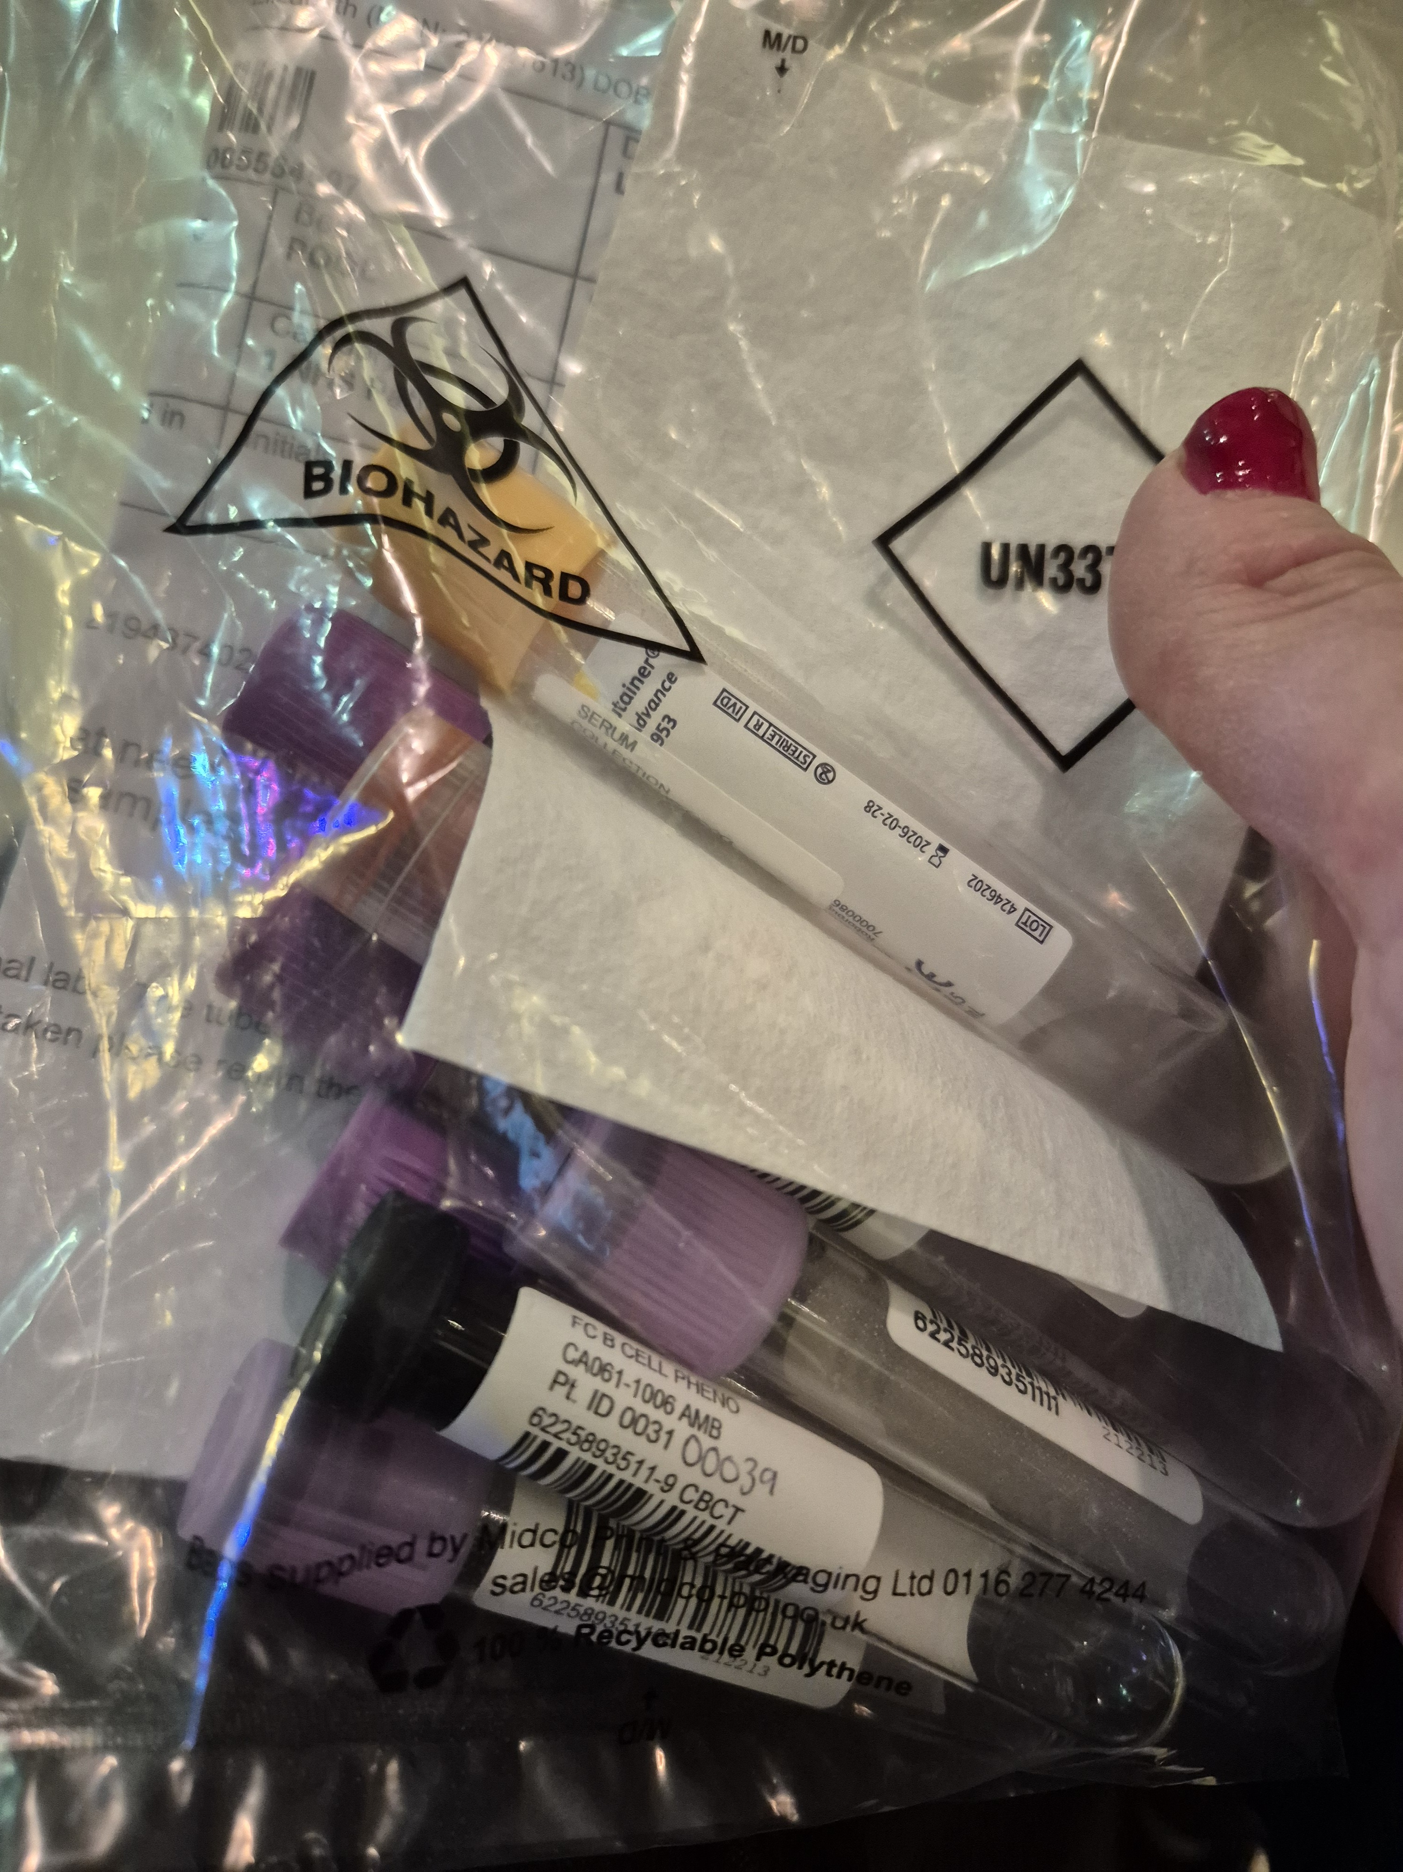
THE TRIAL
Follow-Up Since
01
02
03
04
Weeks 1–2
To month 6
Month 9
Now
Follow-up appointments every couple of days
Then weekly, moving to monthly check-ins
A further review
My annual review is next week
Trial bloods — taken every visit
13
Notes:
Explain how closely you were monitored after being discharged: every couple of days for the first two weeks, then weekly and monthly out to six months, a further review at nine months, and your annual review coming up next week. This shows the audience that the trial's support doesn't stop at discharge.

Slide 14
TODAY
Where I Am Now
Has it worked?
That's the million-pound question.
I haven't got worse — and possibly, even a little better.
What I'm hoping to hear at next week's annual review
More detail and updates on my Instagram vlog: @katesmstrialupdate
14
Notes:
This is the honest heart of the update: nobody can say for certain yet whether it's worked, but the disease hasn't got worse, and there are signs it may even be a little better. Your annual review next week will tell you more — this is a good moment to be candid about living with that uncertainty.

Slide 15
WHAT THIS COULD MEAN
A new source of hope for SPMS
If trials like this succeed, CAR-T could open a route to remission and slower progression for people who currently have almost nowhere else to turn.
Thank you
Questions welcome · Follow my journey: [@your_instagram_handle]
Notes:
Close with a note of hope for the wider SPMS community, thank the group for listening, and open the floor to questions. Mention your Instagram vlog handle so people can follow the fuller story.

